Slide 1
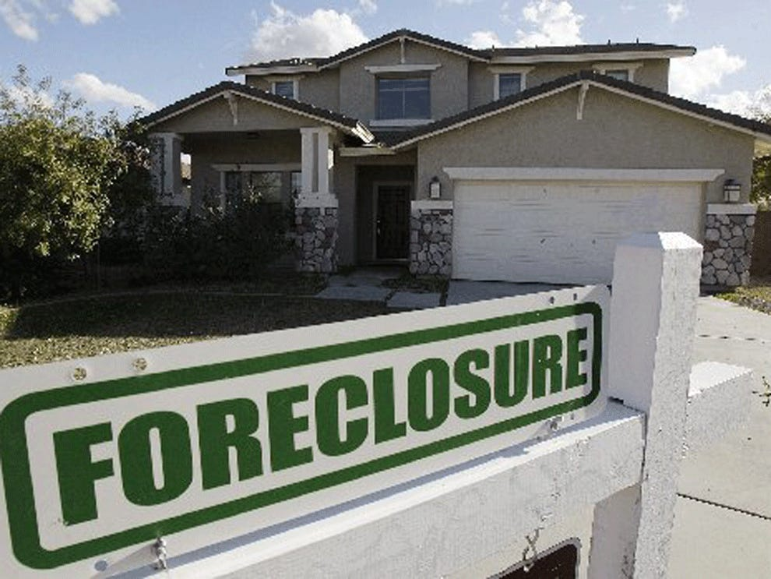

Fannie Mae Default Loan Prediction

Slide 2
Problem Statement Worksheet (Hypothesis Formation)
What standards should FNMA look for when acquiring loans in order to reduce the likelihood of a foreclosure?
1
Context
4
Constraints within solution space
Fannie Mae provides lenders with a reliable source of affordable mortgage financing across the country. Fannie Mae do not originate loans or lend money directly to borrowers, instead it acquires mortgage loans made by lenders and then issue guaranteed mortgage-backed securities (MBS). In the ideal case, someone borrows money from a lender, then repays the loan until the balance is zero. However, some borrowers miss multiple payments, which can cause foreclosure. The process of foreclosure can be very lengthy and cost additional money to the FNMA. The goal is here is to build a predictable model to show whether or not loans acquired by Fannie Mae will go in to foreclosure.
.
predicting model is built using only information that is
available when the loan was acquired
5
Stakeholders to provide key insight
FNMA
2
Criteria for success
Predict whether loan will be foreclosed on in the future
3
Scope of solution space
6
Key data sources
For building the predicting model 2016-2017 year data considered
CSV file downloaded from FNMA website
Notes:
Hypothesis: Create a Hypothesis with an emphasis on SMART principles. (S – Specific, M – Measurable, A – Achievable, R – Realistic, T – Timebound). If you cannot do this, you do not have a good grasp on the business problem.
Context: With context, we have clearly identified the problem at hand and have elucidated on how our initiative may solve this problem, alongside the commercial implications this will have on the business.
Criteria for Success: Clearly defining the criteria for success ensures that the scope of your work is clearly defined and understood. Otherwise, if this isn’t defined – your work will never end which will result in mismatched expectations.
Scope of Solution Space: Scoping out the solution space ensures that the business initiative is SPECIFIC for a certain segment or area. This prevents solutions that have been developed being scaled and applied for all other business units that the solution may not be responsible or scalable for.
Constraints within Solution Space: Looking forward, what are the foreseeable problems we are likely to encounter? Could this be stakeholder resistance? Could this be we don’t have access to the right data?
Stakeholders to provide key insight: Who are the people I need to speak to, to get the answers I need for my data analysis?
What key data sources are required?
Based off my discussions with the key stakeholders – can we clearly list out all the data sources we need so we can make a highly targeted request as opposed to a scatter-gun approach where we ask for a bit of everything?

Slide 3
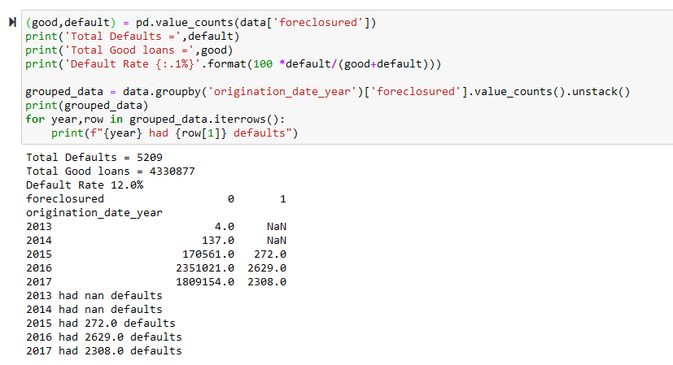
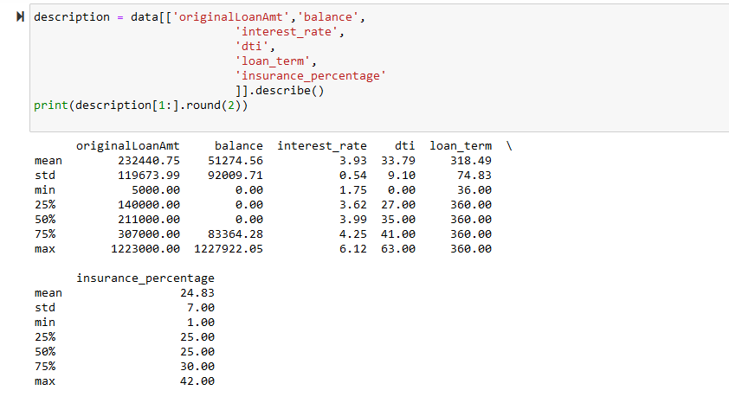
Data Set DetaiLS

Slide 4
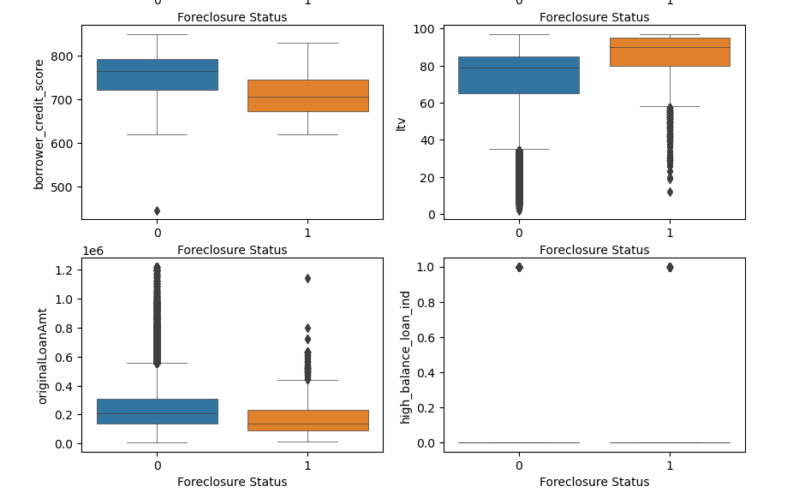
Data Visualization

Slide 5
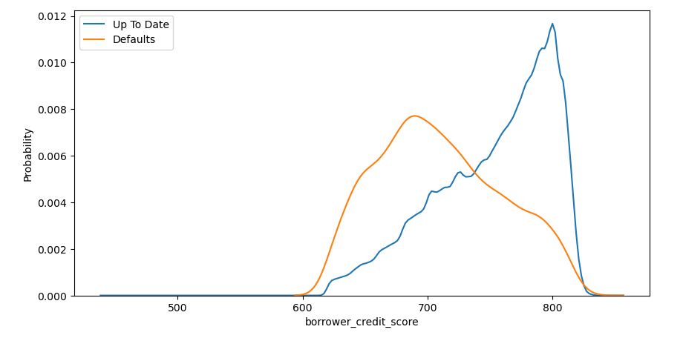
Probability Density graph

Slide 6
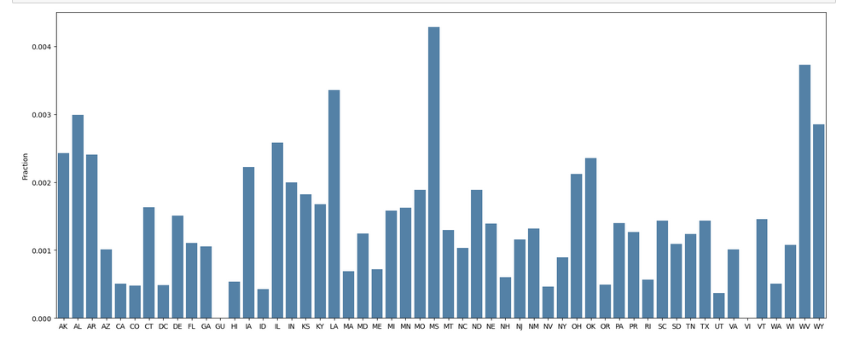
Different States data

Slide 7
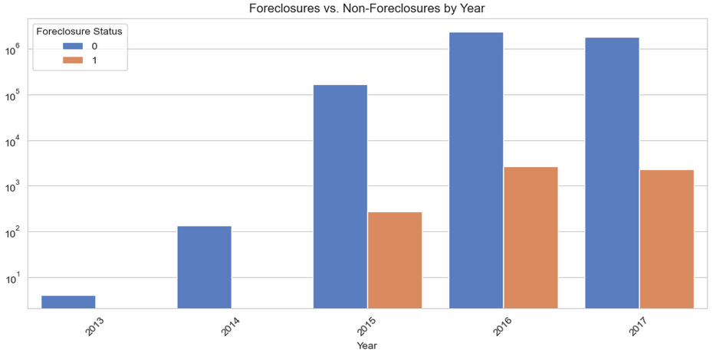
Home foreclosure by origination date

Slide 8
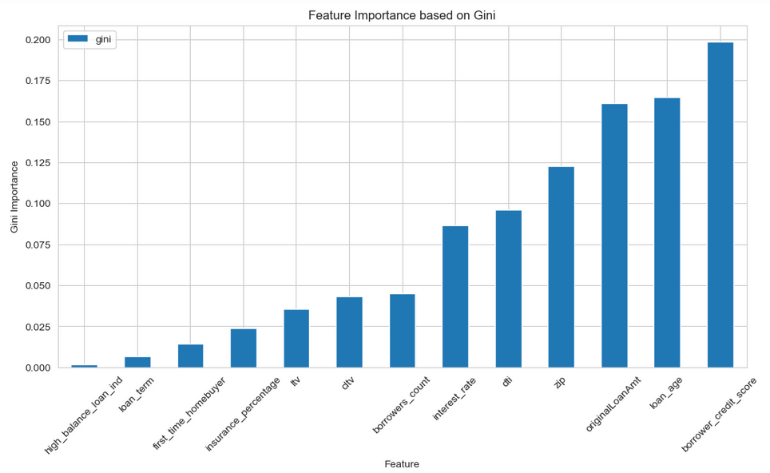

Machine Learning Classifier
SMOTE (Synthetic Minority Over-sampling Technique) from imbalanced-learn library
Manually dividing the dataset to balance each set

Slide 9
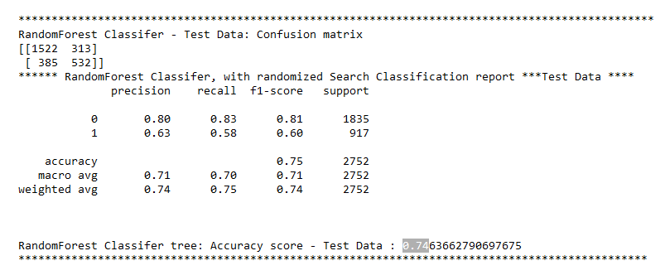
Prediction Results

Slide 10
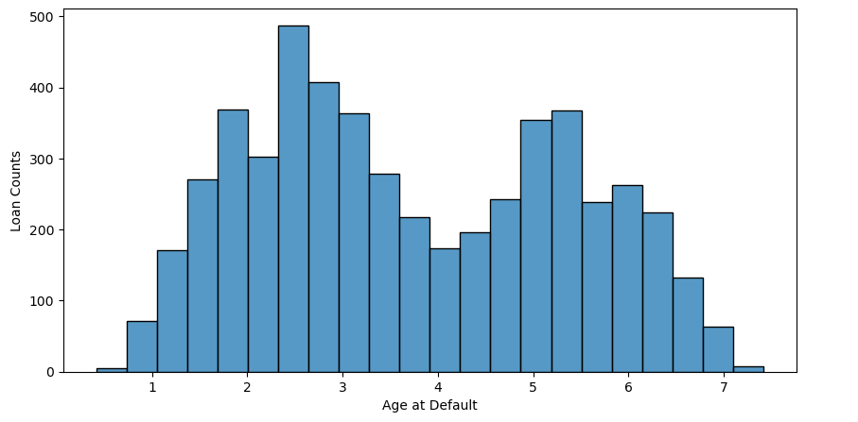
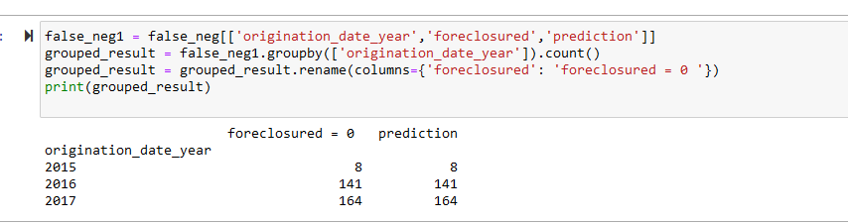

Slide 11
Thank you
- Manjula
data is sourced from fnma website

